Slide 1
Welcome to the EAGE Annual Hackathon! Opening Session

Slide 2




Thank you to our sponsors who made this possible!
Supported by

Slide 3
Photography and recording
Disclaimer – if you do not want your photo taken in person in Madrid, please email the facilitators asap.
This session will be recorded – if you have not received a consent form please email the facilitators asap.

Slide 4
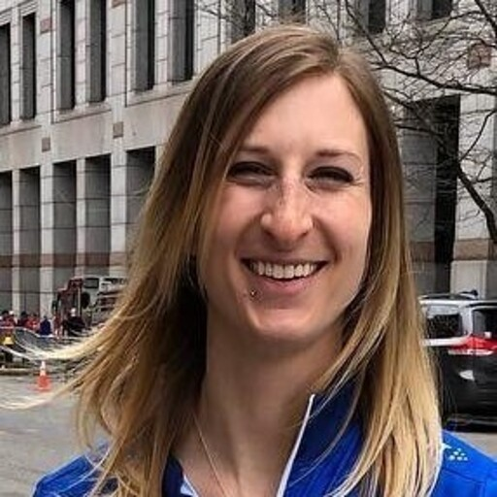

Meet your facilitators – Ashley, Lukas, Oleg and Jan
Ashley Russell (Equinor ASA)
Leader for Data Science and Analytics for subsurface in Equinor. Geologist, self taught data scientist, expertise in Python, data visualization, including interactive plotting and dashboarding, statistics, and machine learning.
@ashleyr (softwareunderground) aruss@equinor.com
Lukas Mosser (Earth Science Analytics)
Lukas Mosser is Head of Research & Development at Earth Science Analytics. Lukas received his P.h.D from Imperial College London, where he worked on the stochastic reconstruction of porous media and geophysical inverse problems using deep learning. He currently also serves as a member of the EAGE AI committee and SEG special interest group for machine learning.

Slide 5
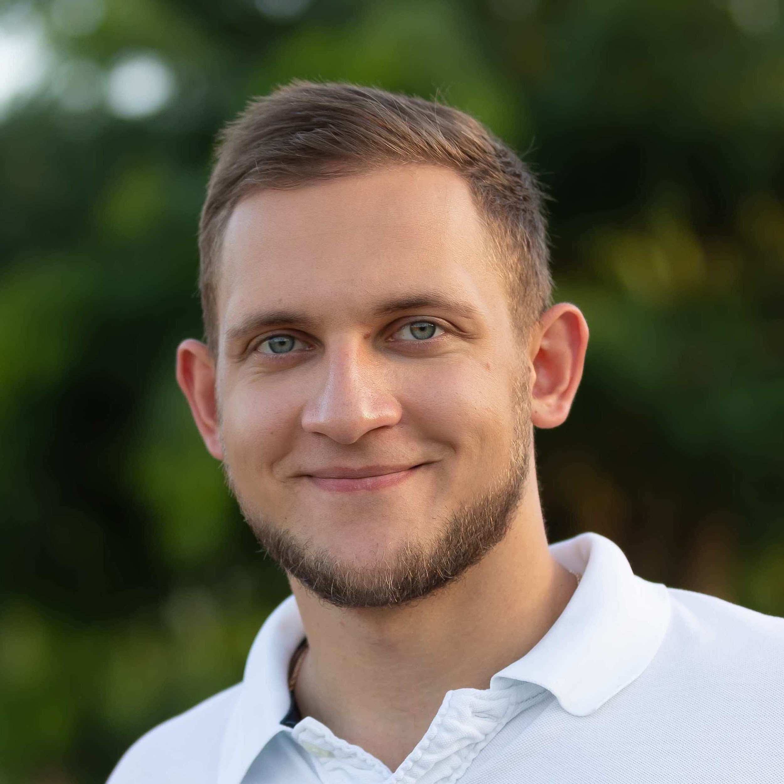
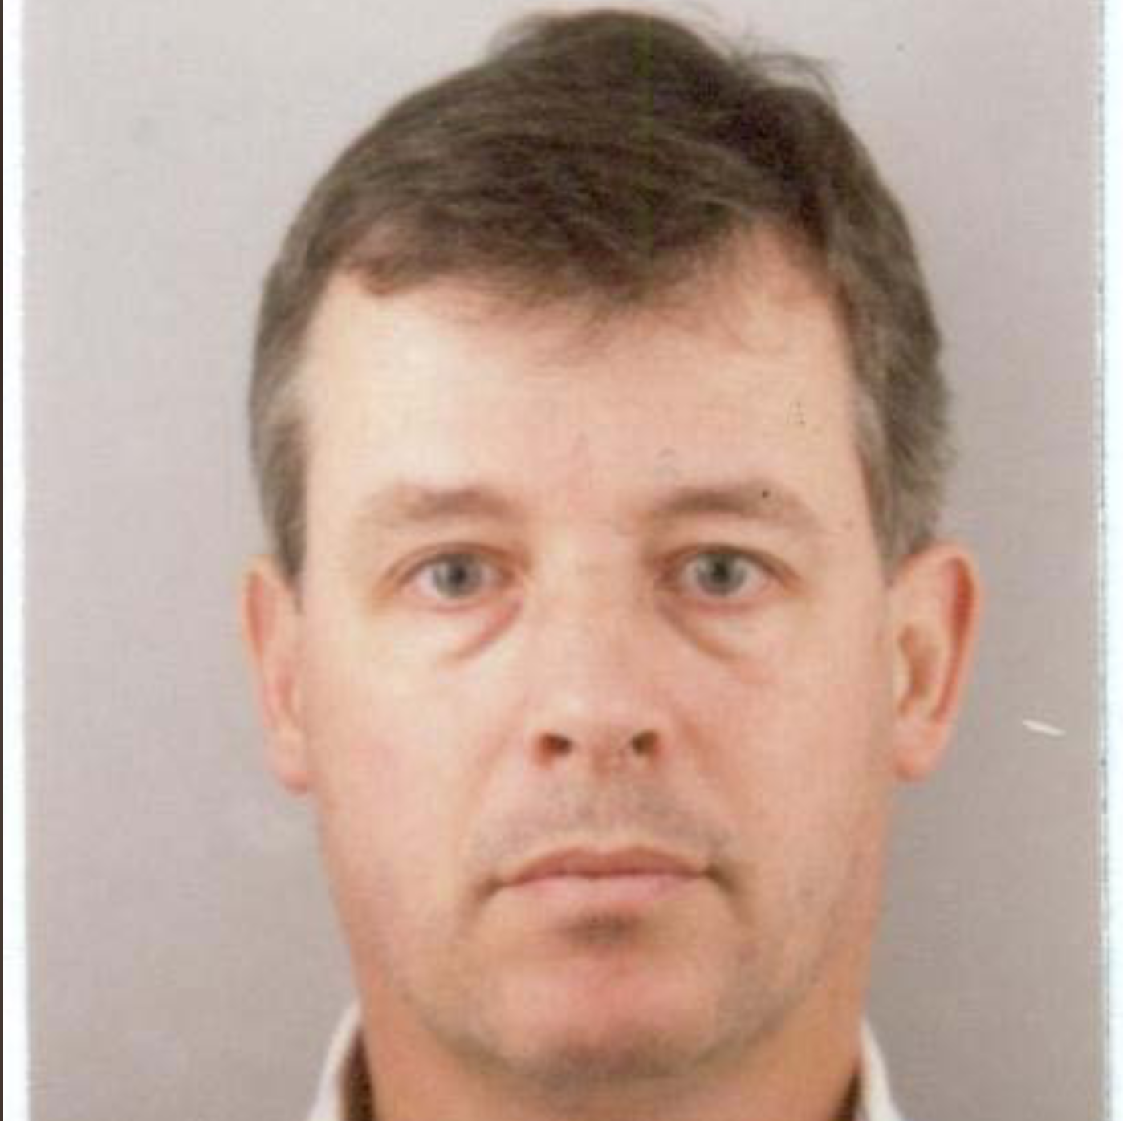
Meet your facilitators – Ashley, Lukas, Oleg and Jan
Oleg Ovcharenko (NVIDIA)
Oleg is Solutions Architect for Energy at NVIDIA. He received his Ph.D from KAUST where he was exploring data-driven methods for the initialization of full-waveform inversion. Oleg is broadly interested in HPC and deep learning applications in geophysics.
Jan van de Mortel (Independent)
Graduated MSc Geophysics in 1988 at the University of Utrecht. After 3 years of freelance work mainly in Far East joined Schlumberger in 1991 until 2011 performing various roles in surface and borehole seismic and quantitative interpretation. Joined Weatherford in 2011 until 2016, managed borehole seismic in Asia Pacific, worked as Region Geophysicist and later as Region Manager in Consulting and Data Services, in Kuala Lumpur and Dubai. Worked for a startup company 2017 to early 2019 specializing in Machine Learning applications in Dubai. Currently working independently as a consultant with main attention in Machine Learning applied to Geosciences

Slide 6
Agenda
Day 1: Sunday, June 5
Day 2: Monday, June 6
9:00 - 9:30 CEST - Welcome and coffee 9:30 - 10:30 CEST – Introduction Plenum Session 10:30 – 11:00 CEST – Project and team discovery time 11:00 - 18:00 CEST - Hacking all day
9:00 - 9:30 CEST - Welcome and coffee 9:30 – 13:00 CEST - Hacking 13:00 CEST: CODE FREEZE – Join online session to receive final presentation criteria (Jitsi) 13:15-15:00 CEST – Time for working and practicing presentations 15:00 - 16:30 CEST - Presentations to the Judging Panel Plenum Session Online (on Jitsi) 16:30 - 17:00 CEST - Announcement of the winners and prizes*

Slide 7
Awards!
There are two awards up for grabs.
These two teams will have their final presentations replayed in the AI special session during the annual meeting!
The winners will also be awarded free access codes for self-paced online courses from NVIDIA Deep Learning Institute
“Best in Show”
A panel of judges will join us for the presentations on the last day and will award this prize.
“Audience Choice”
Each hacker will vote for their favorite team (not their own) and the team with the most votes wins this one!

Slide 8
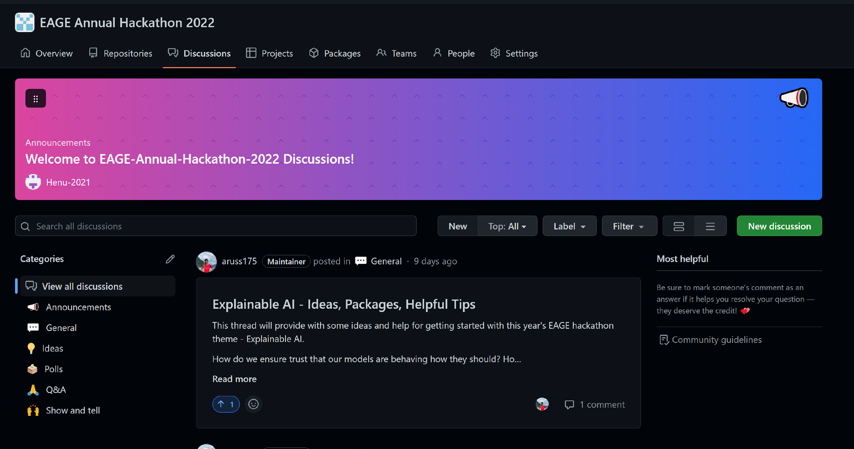
Github will be our main tool during the hack
Please keep on eye on the boards:
Notes:
If you need help getting started on Github – let one of the facilitators know.

Slide 9
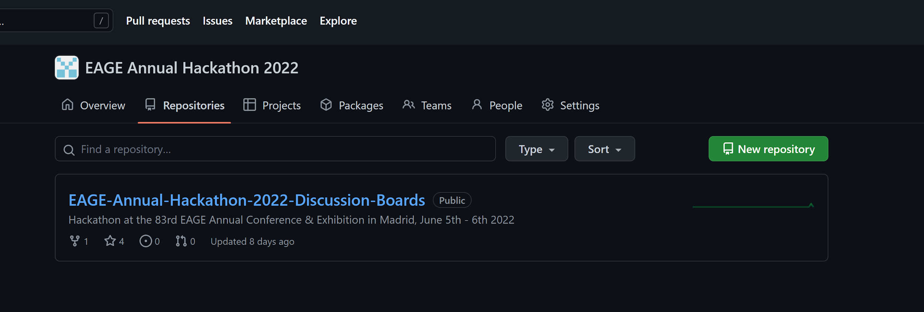
Github will be our main tool during the hack
For each team – please create your own repo for uploading your code and final presentations:
Notes:
If you need help getting started on Github – let one of the facilitators know.

Slide 10
Plenum Sessions are Online (hybrid hack)
Three plenum sessions:
Introduction (now)
Code Freeze and Final Presentation Instructions
Final Presentations
Every plenum session will be on Jitsi Meet at the same link as this one. Make sure you have your VPN off.
You are welcome to have your own team meetings using whichever tool you like.
Notes:
Moderater link: https://moderated.jitsi.net/7bffe47befcf47d6ae1a93ff20fba19cf5a4d3a6ef4a4a758ad9650337b07cb4

Slide 11
Introduction to Interpretability

Slide 12
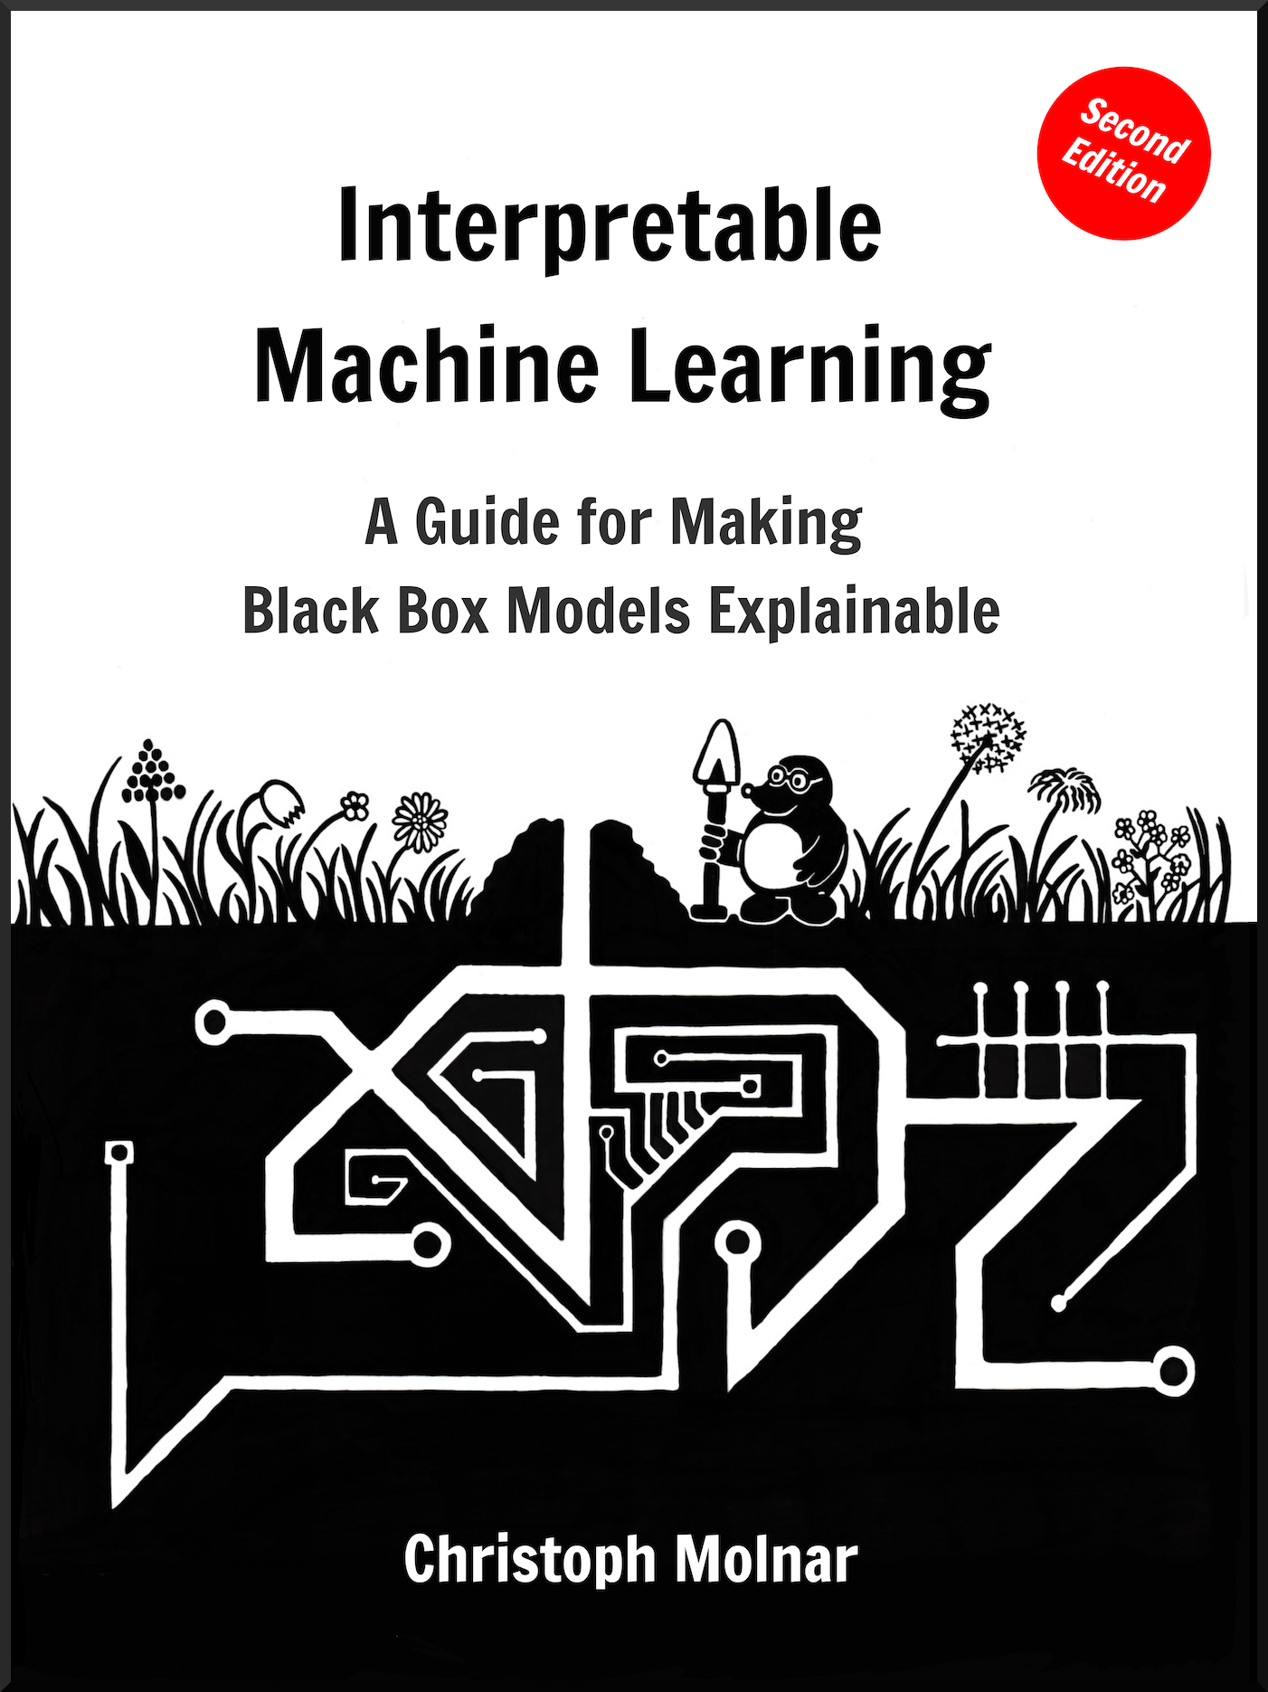
Introduction to Interpretability
https://christophm.github.io/interpretable-ml-book/

Slide 13
What is interpretability?
General: Interpretability is the degree to which a human can understand the cause of a decision.
Model-Oriented: Interpretability is the degree to which a human can consistently predict the model’s result.
Miller (2017):
Interpretable Machine Learning refers to methods and models that make the behavior and predictions of machine learning systems understandable to humans
[Source]

Slide 14

Why and when do we care about interpretability?
Gain knowledge - do science
Safety Measures
Detecting Bias
Social Acceptance
Debugging and auditing
Checking for Traits:
Fairness,
Privacy,
Reliability,
Causality,
Trust
And more…
[Source]

Slide 15
When we might avoid Interpretability?
Our models have no significant impact
Not interested in gaining additional insights on the task
When we anticipate manipulation
Example: Netflix movie recommendation (no significant impact for individual), physical model of a thrown object (well understood),
[Source]

Slide 16
Taxonomy of Interpretability
Intrinsic vs. Post-Hoc methods:
Is interpretability a feature of the model / method, or do we apply a method to analyze a model after it has been obtained / trained.
According to result of the interpretation method:
Feature statistics, Feature visualizations, Model internals, …
Model Specific vs. Model Agnostic Methods
Local vs. Global Methods:
Does the method explain a single prediction, or the entire model as a whole?
[Source]

Slide 17
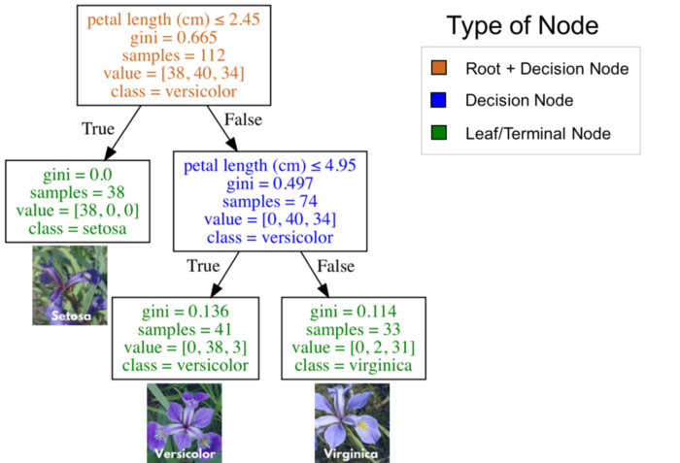
Interpretable Models
Useful properties of models for interpretability:
Linearity: Relationship between features and target is modelled linear
Monotonicity: An increase in a feature will always lead to an increase or decrease of the target. Easier understanding of relationships between inputs and output.
In-built Feature Interactions: Can improve predictive performance, but too complex interactions will hurt interpretability.
Examples of interpretable models: - Linear Regression, Logistic Regression, Decision Trees, RuleFit, Naive Bayes,
[Source]

Slide 18
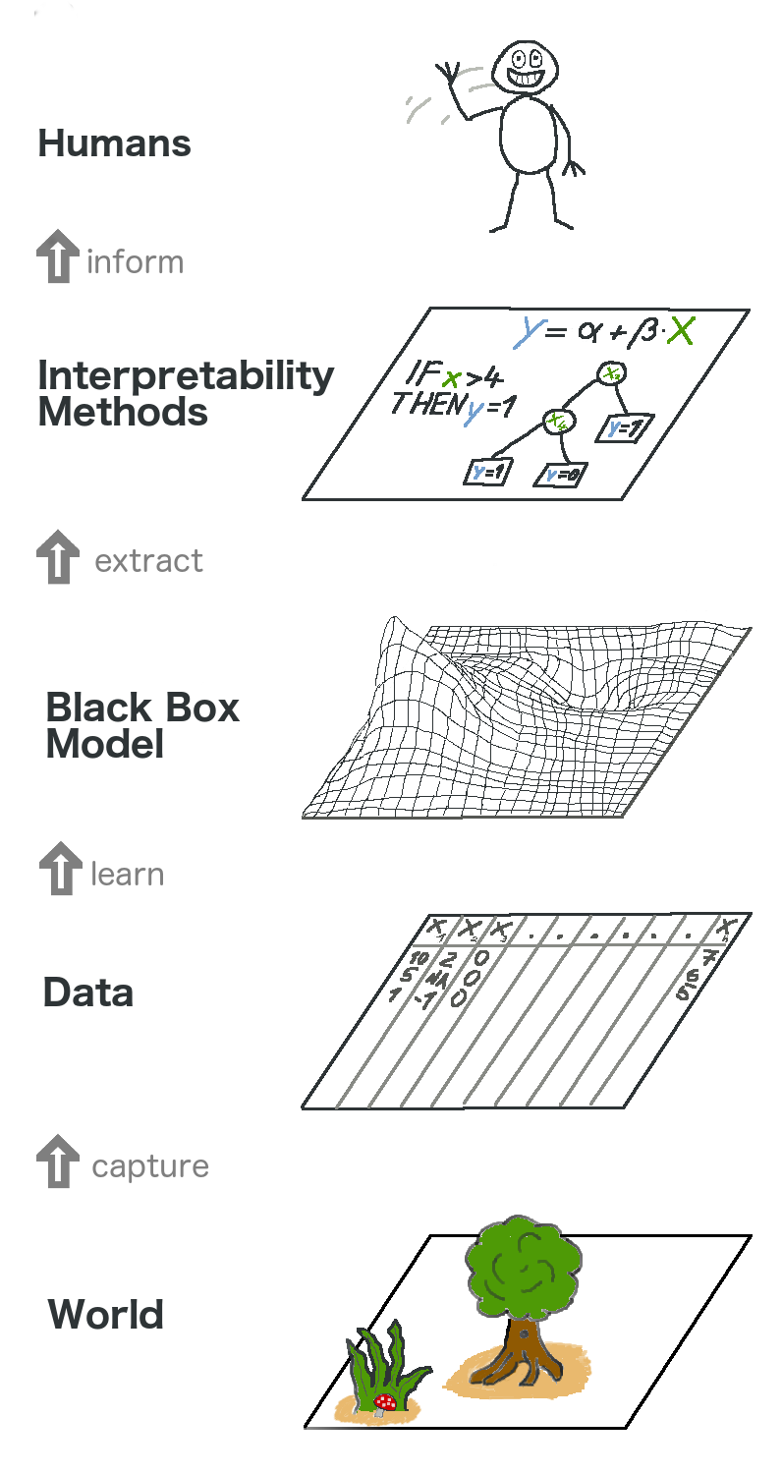
Model Agnostic Methods
Advantage: Flexbility. Use whatever model you like.
Some desireable aspects of Model Agnostic Methods:
Model Flexibility: Can work with any machine learning method
Explanation Flexibility: Not limited to a certain form of explainability e.g. summary statistic vs. a graphic
Representation Flexibility: Should be able to handle different feature representations e.g. database entries vs. word vectors vs. images
[Source]

Slide 19
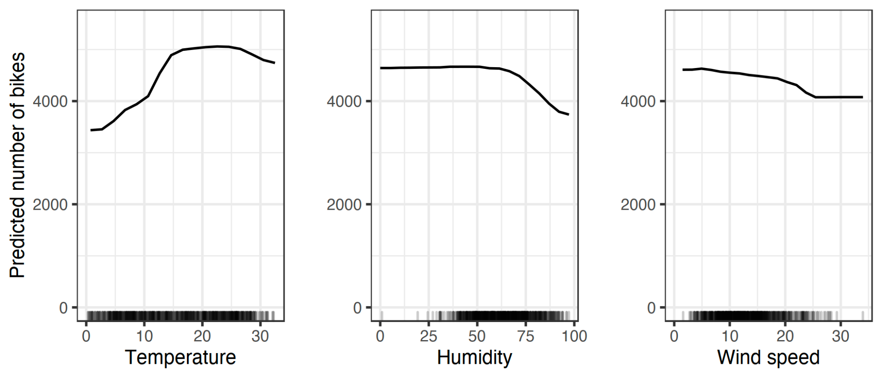
Global Model Agnostic Methods
[Source]
Describe the global average behavior of a machine learning model.
Useful for understanding general mechanisms in the data or debugging.
Methods:
Partial Dependence Plots, Feature Interaction, Permutation Importance, …
PDPs for the bicycle count prediction model and temperature, humidity and wind speed.

Slide 20
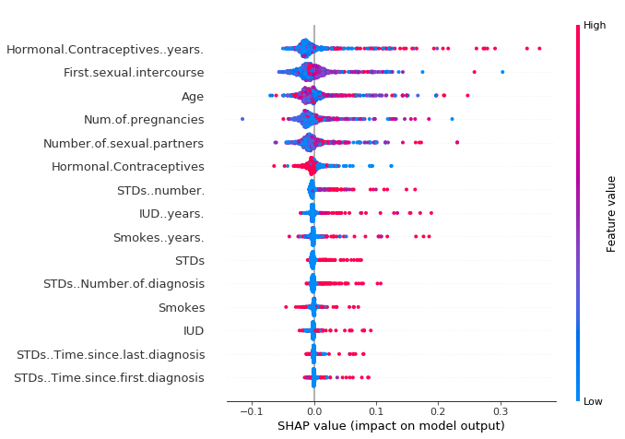
Local Model-Agnostic Methods
These methods explain individual predictions:
Local Surrogate Models (LIME)
Shapley Values
SHAP
Counterfactual Explanations
…
A SHAP summary plot
[Source]

Slide 21
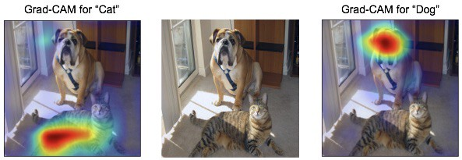
Neural Network Interpretability
Model-agnostic methods can be used, but they do not leverage specific properties of neural networks that can be useful for interpretability e.g feature representations and gradients.
Methods:
Learned Features
Pixel Attribution (Saliency
Adversarial Examples
Abstract Concepts
Influential Instances
[Source]

Slide 22
Some General Recommendations
Be mindful towards others and yourself.
Ask for help
Interact with other teams
Try to close the loop early: data -> model -> interpretability -> learnings
One key item, is better than 100 half-baked things
Focus on things that will get your idea across
Keep it simple, s**** (KISS)
Get to know your teammates, play into your strengths
Maximize learning, over winning. Learning *is* winning.
Presentation is key
Dare to go your own way: Every hackathon, project, team, and individual are unique.
Source: Accumulated Hackathon Experience

Slide 23
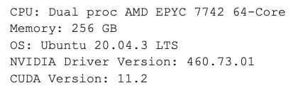
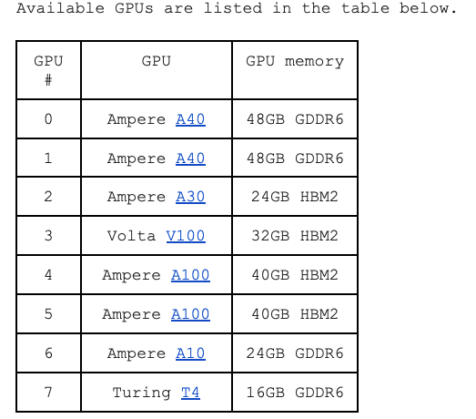
GPU resources
Connect to login node:
ssh you_login@nvpoc.ddnsfree.com
Run interactive session:
srun --gpus N --pty bash -i
NVIDIA Docker Container Repository
https://catalog.ngc.nvidia.com/
Full details:
https://docs.google.com/document/d/1ce94uqAhiggMm9IQvgMElNZiI-T3XDTklsjPcpcv0qA/edit?usp=sharing

Slide 24
Some Hackathon Tips
Take screenshots as you go along – this will save a lot of time when you come to preparing the final presentation
A little planning goes a long way – post its to organize your work or making a list can help keep focus. For those online try using a Jamboard (https://jamboard.google.com/) or Github Issues
By the end of the day today you should have settled on a specific case, sketched out a plan, and have started some work.

Slide 25
Reminder: Hackathons aren’t about getting a perfect solution or answer – it is about trying something new, being bold and learning along the way ☺

Slide 26
Icebreaker!

